Slide 1
A HOLISTIC APPROACH ON AIRFARE PRICE PREDICTION USING MACHINE LEARNING TECHNIQUES
Team Details
A.Rajavamshi Goud(20EG105454)
K.Vinay(20EG105458)
T.Ajay(20EG105459)
Project Supervisor
Dr. B.V.V Siva Prasad
Associate Professor.

Slide 2
Introduction
Approximately 50 years ago airline flights were considered a luxury. Airline companies were launching more domestic flights than international while pricing policies for flight tickets were static. To increase profitability, airline companies adopted management and economical software systems to perform route optimizations, reservation adaptation, and dynamic pricing. An evolution in airline companies was the adoption of yield management, which was a variable pricing strategy based on understanding, anticipating, and influencing consumer behaviour so as to reach the highest revenues. As a consequence, airline companies started to pay more attention to customers’ preferences and experiences during flights, simultaneously increasing the destinations at an international level. Thus, airline flights became accessible to all potential consumers since dynamic pricing and extra flight services increased the competition between airline companies. Moreover, in recent years, the ability to shop online revolutionized many different fields and became a trend among modern people, seeking the most favorable offers and prices.

Slide 3
Literature
Author(s) | Method | Advantages | Disadvantages
Vu et al | Implemented an airfare price prediction application using two ML models and focusing on features related to time for Vietnamese national airline company flights. | Specific focus on time-related features. | Limited number of models considered and focus on a single airline company.
Theofanis Kalampokas | Constructed a custom RNN and compared it with classical ML models in airfare price prediction, incorporating features related to both basketball matches and airline flights. | Integration of features from different domains. | Lack of information about the specific models used and limited explanation of the results.
Joshi et al | Applied feature selection algorithms and hyperparameter optimization to find optimal model parameters and features for flight description in airfare price prediction. | Emphasis on feature selection and optimization techniques. | Limited information about the specific ML models used and their performance.

Slide 4
Problem Statement
To analyze and predict airfare prices using ML Techniques. A comprehensive set of features is extracted from a dataset of flights for popular international destinations. Machine Learning, Deep Learning and Quantum Machine Learning models are employed to achieve accuracies for predicting ticket costs and help cost conscious travelers find the most affordable options.
Objective
To develop a system that can effectively analyze and predict airfare prices for popular international destinations using wide range of Machine Learning techniques, Deep Learning, and Quantum Machine Learning. are the parameters considered in the project.

Slide 5
EXISTING METHOD:
Artificial Intelligence attracts high interest from the research community in many research fields. Machine Learning (ML) was the first introduced domain of AI by Walter Pitts and Warren McCulloch in 1943 where a mathematical model of a biological neuron was proposed with no learning capabilities. Seven years later, in 1950, Frank Rosenblatt proposed the perceptron as the first neural network (NN) with learning abilities. Perceptron was an inspiration for researchers to design and implement subsequently many well-known ML models like SVM, KNN, and Boosting methods. ML models couldn’t robustly generalize without a supporting feature extraction mechanism. The latter requirement was handled by the Deep Learning (DL) domain, increasing the computational demands and reducing the execution time. The flagship for the rise of the DL domain was the introduction of convolutional neural networks (CNN) by Fukushima in 1980 who used a NN for visual pattern recognition. A distinct boost towards this effort came from Yann LeCun in 1990, who used CNN models with backpropagation learning in order to recognize handwritten digits from images. DL models have automated the feature extraction process giving the capability to fabricate more complex algorithms and applications, that impact human daily lives. However, even today, due to the huge data growth rate and despite the evolution of computational hardware (GPUs), there is still a need for faster and more compact ML and DL algorithms.

Slide 6
DISADVANTAGES OF EXISTING SYSTEM:
ML models couldn’t robustly generalize without a supporting feature extraction mechanism
There is still a need for faster and more compact ML and DL algorithms

Slide 7
Proposed Method
This work comes as a follow-up of a previous work on Airfare price prediction. A set of features that characterize a typical flight are extracted and used under the scheme of airfare price prediction for different airline companies and destinations in order to highlight their level of competition and provide a holistic approach to the problem. Moreover, the range of ML, DL, and QML models’ applicability and performance is examined holistically in airfare price prediction. Two experiments are conducted; in the first experiment, the problem is studied from the destination perspective (destination-based approach) for each airline company, and the AI models from the above three domains are applied to the same set of destinations for different airline companies in order to highlight similarities among the performance of models; in the second experiment, the ML, DL, and QML models are applied in datasets for each Airline company (airline-based approach), independently from the destination. It should be highlighted here, that this work is the first reported attempt towards a holistic approach to the problem of airfare price prediction, where the problem is examined as a whole, covering both approaches, from the side of destinations and from the side of airline companies. Moreover, it should be noted that QML has never been applied before to the airfare price prediction problem, as far as our knowledge.

Slide 8
ADVANTAGES FOR PROPOSED SYSTEM
Experimental results reveal that at least three models from each domain, ML, DL, and QML, are able to achieve accuracies between 89% and 99% in this regression problem, for different international destinations and airline companies.
Results reveal that by using AI models and flight features that are available to customers before purchase, the airline company ticket price policy can be efficiently analyzed.

Slide 9
PARAMETERS:
Accuracy.
Regression performance.
Destination based approach.
Airline based approach.
Comparative evaluation.
Relative performance.

Slide 10
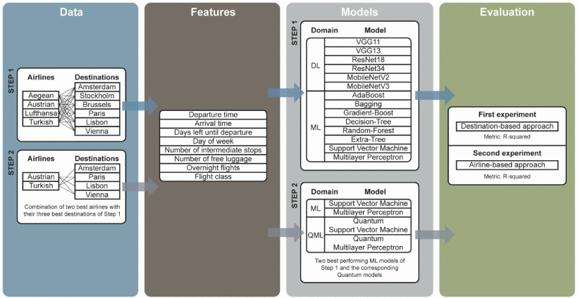
SYSTEM ARCHITECTURE:

Slide 11
Project status
S.No | Functionality | Status (Completed /in-progress/Not started)
1. | Data Exploration | Completed
2. | Data Processing | In progress
3. | Data Splitting (Train & Test) | In progress
4. | Model Generation - First Experiment | In progress
5. | Model Generation - Second Experiment | Not started
6. | User Signup & Login | Completed
7. | Prediction | Not Started
Note: Submit Form 1,2 and 3

Slide 12
References
[1] S. Netessine and R. Shumsky, ‘‘Introduction to the theory and practice of yield management,’’ INFORMS Trans. Educ., vol. 3, no. 1, pp. 34–44, Sep. 2002.
[2] W. S. McCulloch and W. Pitts, ‘‘A logical calculus of the ideas immanent in nervous activity,’’ Bull. Math. Biophys., vol. 5, no. 4, pp. 115–133, Dec. 1943.
[3] F. Rosenblatt, ‘‘The perceptron: A probabilistic model for information storage and organization in the brain,’’ Psychol. Rev., vol. 65, no. 6, pp. 386–408, 1958.
[4] B. E. Boser, I. M. Guyon, and V. N. Vapnik, ‘‘A training algorithm for optimal margin classifiers,’’ in Proc. 5th Annu. workshop Comput. Learn. theory, Jul. 1992, pp. 144–152.
[5] E. Fix and J. L. Hodges, ‘‘Discriminatory analysis. Nonparametric discrimination: Consistency properties,’’ Int. Stat. Rev./Revue Internationale de Statistique, vol. 57, no. 3, p. 238, Dec. 1989.

